Slide 1
Medical Funding Professionals
CPVS™ Funding Roadmap for
Start Presentation

Slide 2
Agenda
01
02
About Regulation A+
03
Capital Planning Valuation Strategy™
Introductions
07
05
06
04
Your CPVS™ Assessment
Investor Acquisition
Bridge Funding
Next Steps
Medical Funding Professionals

Slide 3
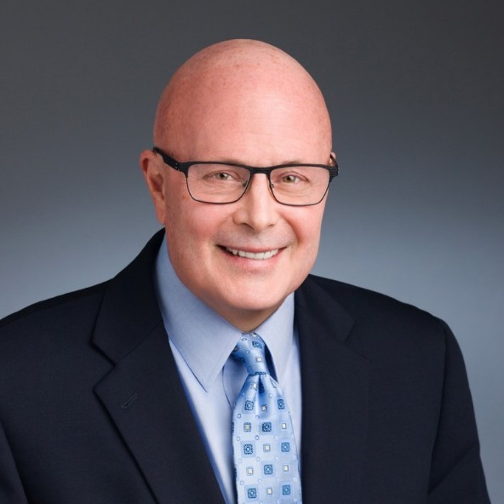
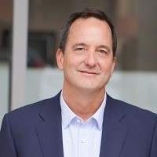
CPVS™ Co-Chairs
Stephen Brock
Scott Pantel
Medical Funding Professionals
CEO, Medical Funding Professionals
CEO, Life Science Intelligence & Emerging Medtech Summit
22 years in finance, registered investment adviser
23 years in medtech market research

Slide 4
Our Mission
We leverage the democratization of capital to help medical innovators bring life-saving and life-changing products to patients while keeping control and ownership of their company.
Medical Funding Professionals

Slide 5
The Democratization of Capital
“
To prosper, people need wide and deep access to capital markets at home and abroad.
Research shows that economies fare best where capital is cheap, plentiful and fairly allocated.
”
Medical Funding Professionals
Forbes

Slide 6
3 Commitments for a Successful Raise
1
You have to commit to the fact that you need outside investor capital and need to access the capital markets
2
You have to commit to the fact you have a company and opportunity investors will find appealing
Medical Funding Professionals
3
You have to commit to the proper SEC compliant process, marketing budget and team needed to get you on market

Slide 7
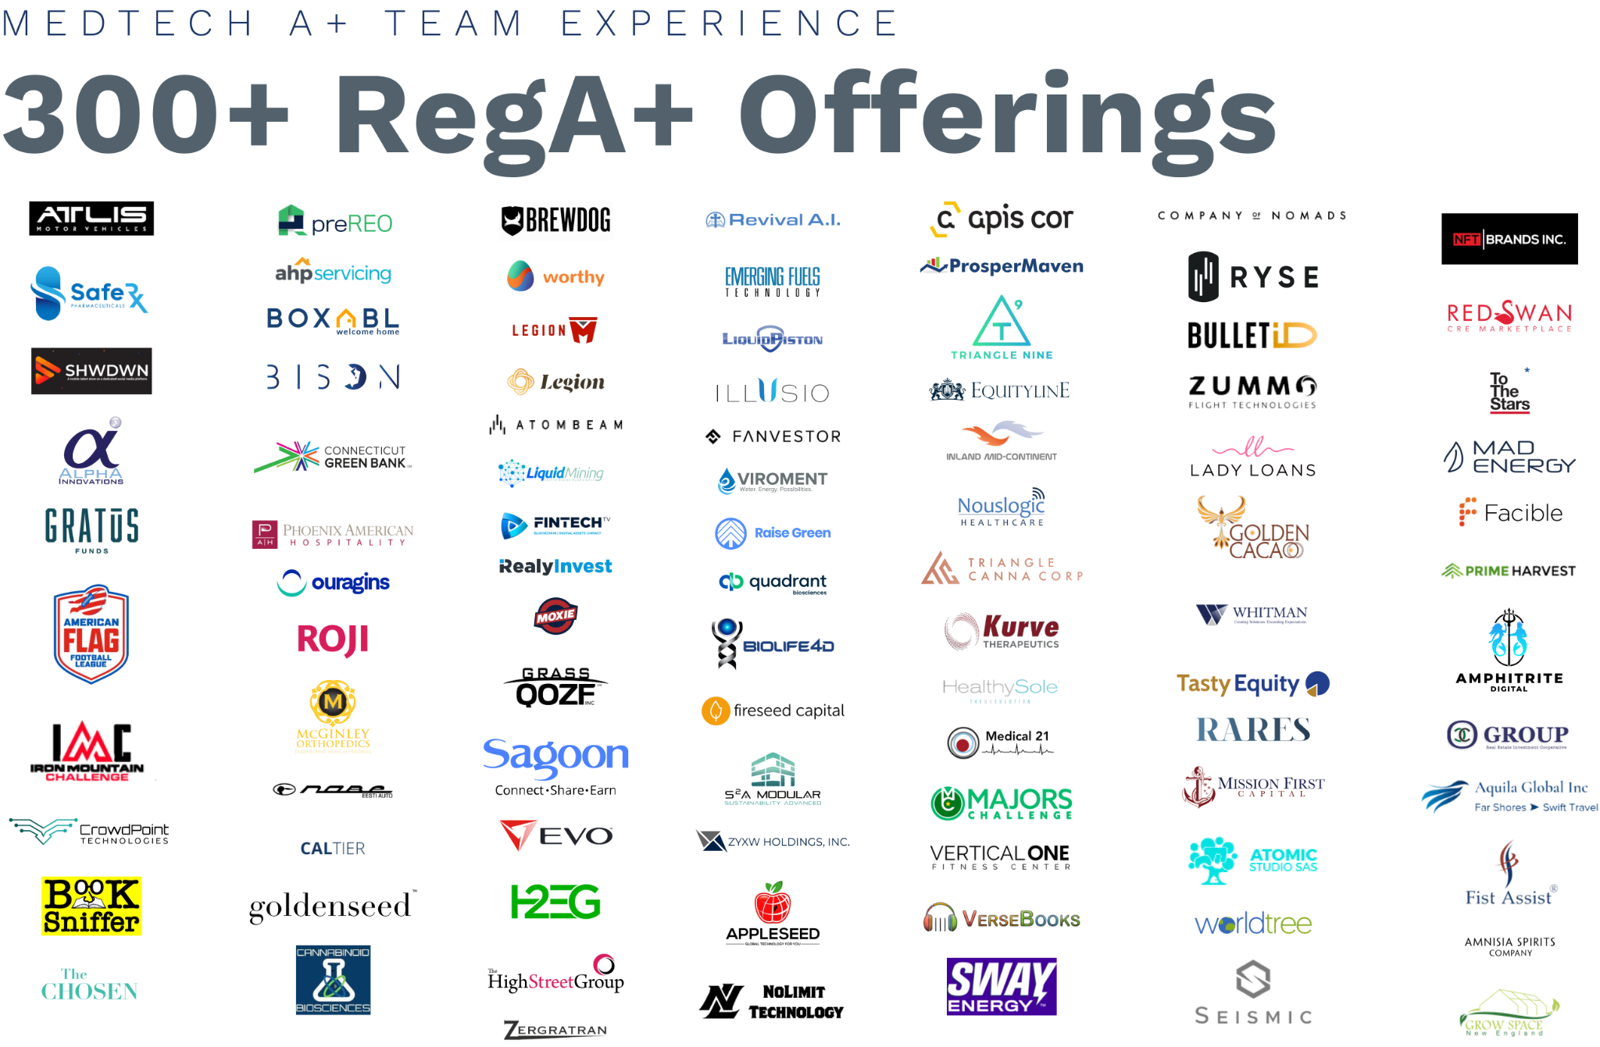
Medical Funding Professionals
Medical Funding Professionals

Slide 8
With Reg A+ you can raise up to
$75 million every 12 months,
from the public, in the U.S. and Canada.
Raise Funds Easier,
Faster
and at
Lower Cost
Viable alternative to venture capital
Wider capital market – both accredited and non-accredited (over half of A+ funding is from accredited investors)
Maintain control – higher valuations mean giving up less equity
More accessible – no minimum raise, no lead investor, more open to non-traditional founders
Maintain momentum – outsource investor acquisition so CEO doesn’t spend 6 months raising money full-time
Monetization – shares are freely tradable in secondary markets after closing
Lower compliance burden – simpler registration, fewer ongoing filings than IPO
Increased visibility – M&A opportunities, customers & partners
Investor community – impact investors become advocates for your company
Medical Funding Professionals
Learn more about Regulation A+

Slide 9
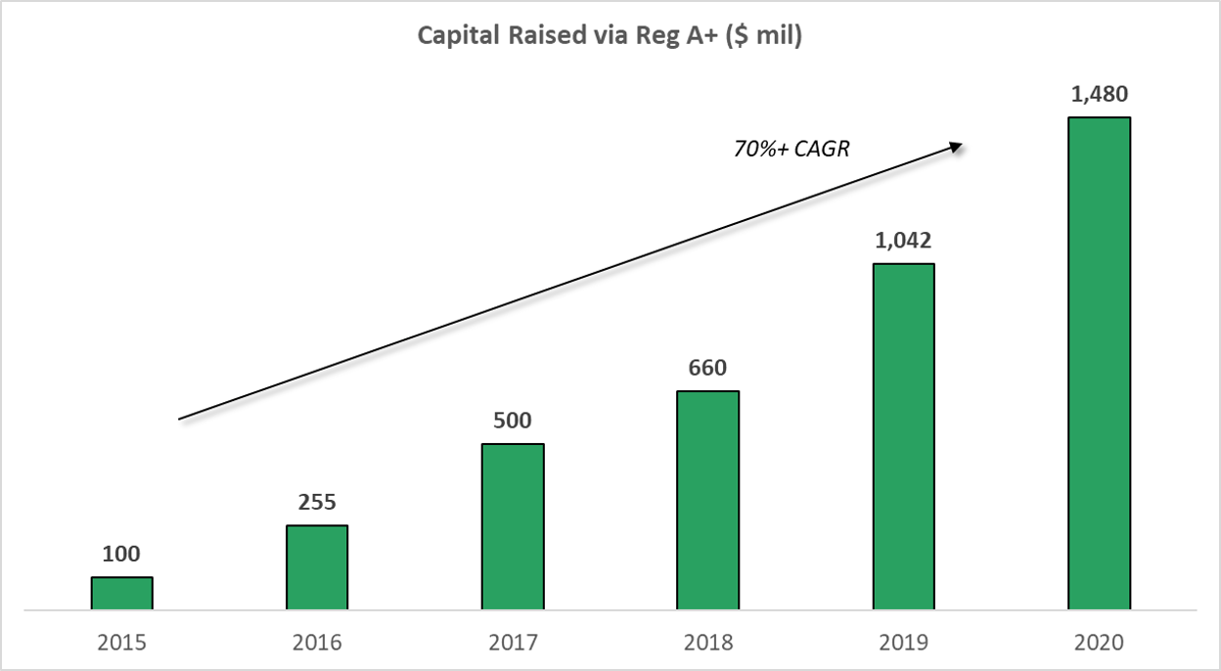
Through 2020, Reg A+ offerings have raised more than $4 billion across 469 issuers—$9 million per issuer on average—with nearly $1.5 billion raised in 2020 alone – a 42% year-over-year increase.
Reg A+ Funding Growth
With over 200 Reg A+ offerings filed through June, 2021 is on track to accelerate that growth.
Medical Funding Professionals

Slide 10
Some Reg A+ offerings of note:
Reg A+ Funding Success Stories
BrewDog launched its Reg A+ offering and just eight months later, PE firm TSG Consumer Partners committed to invest, pushing BrewDog’s valuation to $1.2 billion, making it the first Reg A+ Unicorn.
VidAngel raised $10 million in 5 days from investors, by promoting their offering to their most active customers.
NowRx raised their target $20 million for their on-demand, same-day-delivery pharmacy. They made exceptionally good use of marketing and PR.
Emerald Health Pharmaceuticals raised $60M for their biopharmaceutical company, pre-revenue and pre-clinical.
Medical Funding Professionals

Slide 11
Leverage technology to streamline your fundraising efforts and investor relations.
Raise
Money Digitally
Reach potential investors through Facebook & Instagram ads, LinkedIn, mass e-mail, and online PR.
Tell your story through digital content, social media, videos, and webinars.
Track and communicate with your prospects and shareholders through CRM.
INVEST NOW button on your website allows investors to buy your stock immediately, often from their mobile phone.
Automated processing of investor due diligence, including tax forms, accreditation, and AML checks.
Digital stock transfer agent tracks shareholders’ stock as ledger entries, not paper certificates.
Online portal for managing cap tables with unlimited investors.
Medical Funding Professionals

Slide 12
Capital Planning Valuation Strategy™ (CPVS)
How We Do This
Long-Term Capital Strategy
Cap Table Restructuring
Market-based Valuation
Legal Background Safety
Corporate Books Management
Reorganization of corporate charters/examptions
Fundraising Planning
Bridge Funding Raise
Regulation A+ Raise
Market Research
Industry Strategy
Industry Access
Branding & Positioning
Investor Acquisition
Investor Relations
Medical Funding Professionals

Slide 13
It Takes a Team
Capital Planning
Fintech Investment Platform
Stock Transfer Agent
FINRA Broker-Dealer
Blue Sky Registration & Compliance
Foundational Legal
Offering Preparation
Compliance
Market Research
Auditor
Investor Acquisition
Investor Relations
Medical Funding Professionals
Admin Support
IRA Custodian
Escrow
Grants
M&A
ATS Secondary Market

Slide 14
LSI Benefits
Medical Funding Professionals

Slide 15
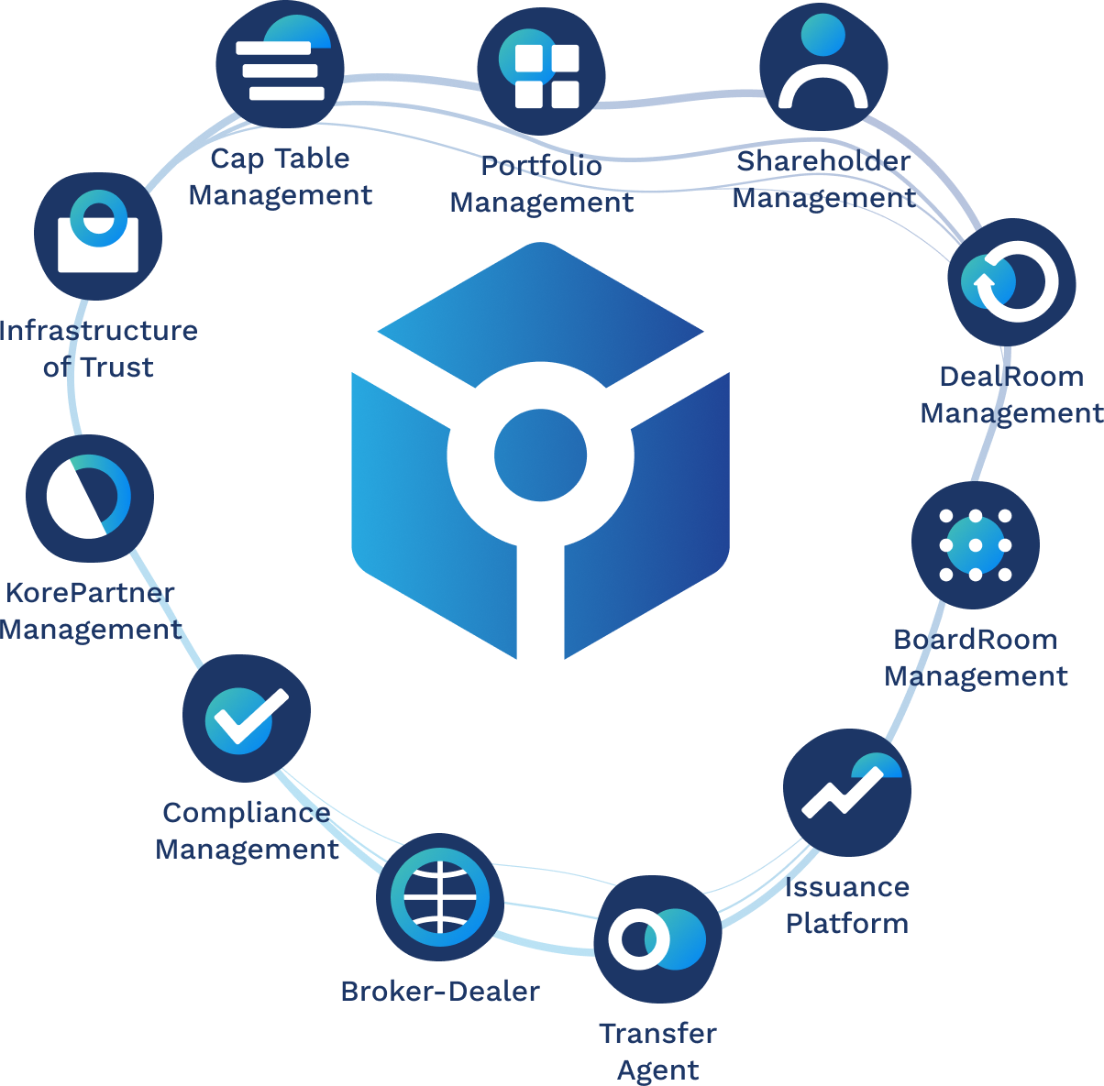
KoreConX Fintech Platform
Medical Funding Professionals

Slide 16
The proprietary CPVS™ positions your firm to secure up to $75 million per year through Regulation A+.
A CPVS assessment provides a solid foundation of information for decisions about future capital funding efforts.
Capital Planning Valuation Strategy™ Assessment
Pro-forma capitalization table reflecting the current capitalization structure of the company and the projected capitalization table following potential investments,
Pre- and post-money valuations of the company,
Selling shareholders analysis, showing how current shareholders can have a limited liquidity event in the Reg A+ offering,
Description of the sequential steps in the process ending with a financial offering in spreadsheet form, and
Synopsis with the steps of the funding process, i.e., the capital and cash flow projection beginning post-registration and ending with receipt of offering proceeds.
Medical Funding Professionals

Slide 17
Business owners who have completed the assessment tell us that they can make funding decisions with greater confidence due to:
Capital Planning Valuation Strategy™ Benefits
Knowing how potential investors will view their company.
Understanding how much capital they need to implement their business strategy and the funding realistically possible. The knowledge reduces the likelihood of leaving money on the table or losing control of your company at the economic and governance levels. Yes, you can bypass outsiders gaining control of your company by tapping into resources few businesses leaders know exist.
Anticipating regulatory, and compliance requirements associated with a funding.
Recognizing the normal ebbs and flows of a funding process whether issuing equity, warrants, debt, or convertible securities. This knowledge enables owners to maintain and increase valuable momentum during scale up.
Promoting A+ offerings as an incentive for a 506(c) funding round (Seed, Series A, B, or more.
Medical Funding Professionals

Slide 18
CPVS™ Custom Pro Forma Cap Table
The experts at Medical Funding Professionals have prepared a pro forma capitalization table for you using the proprietary CPVS and the documentation you provided, with the primary goal being to maximize founder and senior executive control of the company throughout your future fundraising.
The proposed cap table includes:
Detailed cap table
Pre- & post- valuation summary
Selling shareholders analysis
PitchBook™ comparable deal analysis
PitchBook™ comparable investor analytics
Medical Funding Professionals
View / Download

Slide 19
CPVS™
Pre- and
Post-Valuation
Based on the proposed cap table, we have created a simplified view of the proposed pre- and post-valuation for a Reg A+ offering.
With Reg A+ your pre- and post-valuations have the potential to be much higher than they would be using traditional approaches, such as angel or VC private offerings.
Medical Funding Professionals
View / Download

Slide 20
CPVS™
Pro Forma Capital & Cash Flow
Our pro forma capital & cash flow analysis lays out the timeline of expenses and anticipated investment inflows to support your cash flow planning.
A significant advantage of the Reg A+ approach is that most investors pay with a credit or debit card, and inflows can be swept into your account as they come in.
Medical Funding Professionals
View / Download

Slide 21
SEC
Filing & Offering Preparation
23 Years in Business
5,500 Securities Offerings Prepared
RegD, RegCF & RegA+ Offering Preparations
SEC Filing Preparation and Investor Web Portal Builds with KoreConX Integrations all under one roof
80% of submitted Reg A+ Form 1A are SEC “no comment” reducing SEC qualification timeframes for the client
Fixed Rate Rees for RegD, RegCF and RegA+ Offerings
In house EDGAR Filing Conversions
800 Firm FINRA Broker-dealer community
Quarterback Approach to Offering Preparation to Provide Maximum Efficiency for the Client
100% success track record on Reg A+ filing qualifications
Medical Funding Professionals

Slide 22
Audit
CPA Firm
Assurance, Tax, Advisory
40+ RegA+ Audits 2021
Medical Funding Professionals

Slide 23
FINRA Broker-Dealers
FINRA Broker-Dealer
Registered in All 50 States
Experience Compliance Teams
Role in Offering
Broker-Dealer of Record
Bro-Dealer with compliant call center
Provide different levels of service 1%-3%
Each offering is different
Bridge Funding Raise
Regulation A+ Raise
Regulation CF
Regulation D
Secondary Market Trading
Medical Funding Professionals

Slide 24
Effective marketing is a critical success factor for Reg A+ offerings.
Non-accredited investors are different from VCs. Due diligence consists of minutes or hours, not days or weeks—a landing page, a couple of videos, and a Google search.
They are impact investors—what’s your “why”? How will your product make people’s lives better and change the world?
“Sell the story, not the stock” —build your brand, don’t just promote your offering.
Brand marketing, in combination with digital advertising, increases ROAS (Return on Ad Spend).
Reap additional benefits by raising awareness with potential customers, strategic partners, and M&A opportunities.
Strong brands deliver 20% higher average market cap.
Sell the Story, not the Stock
Medical Funding Professionals

Slide 25
Medical Funding Professionals

Slide 26
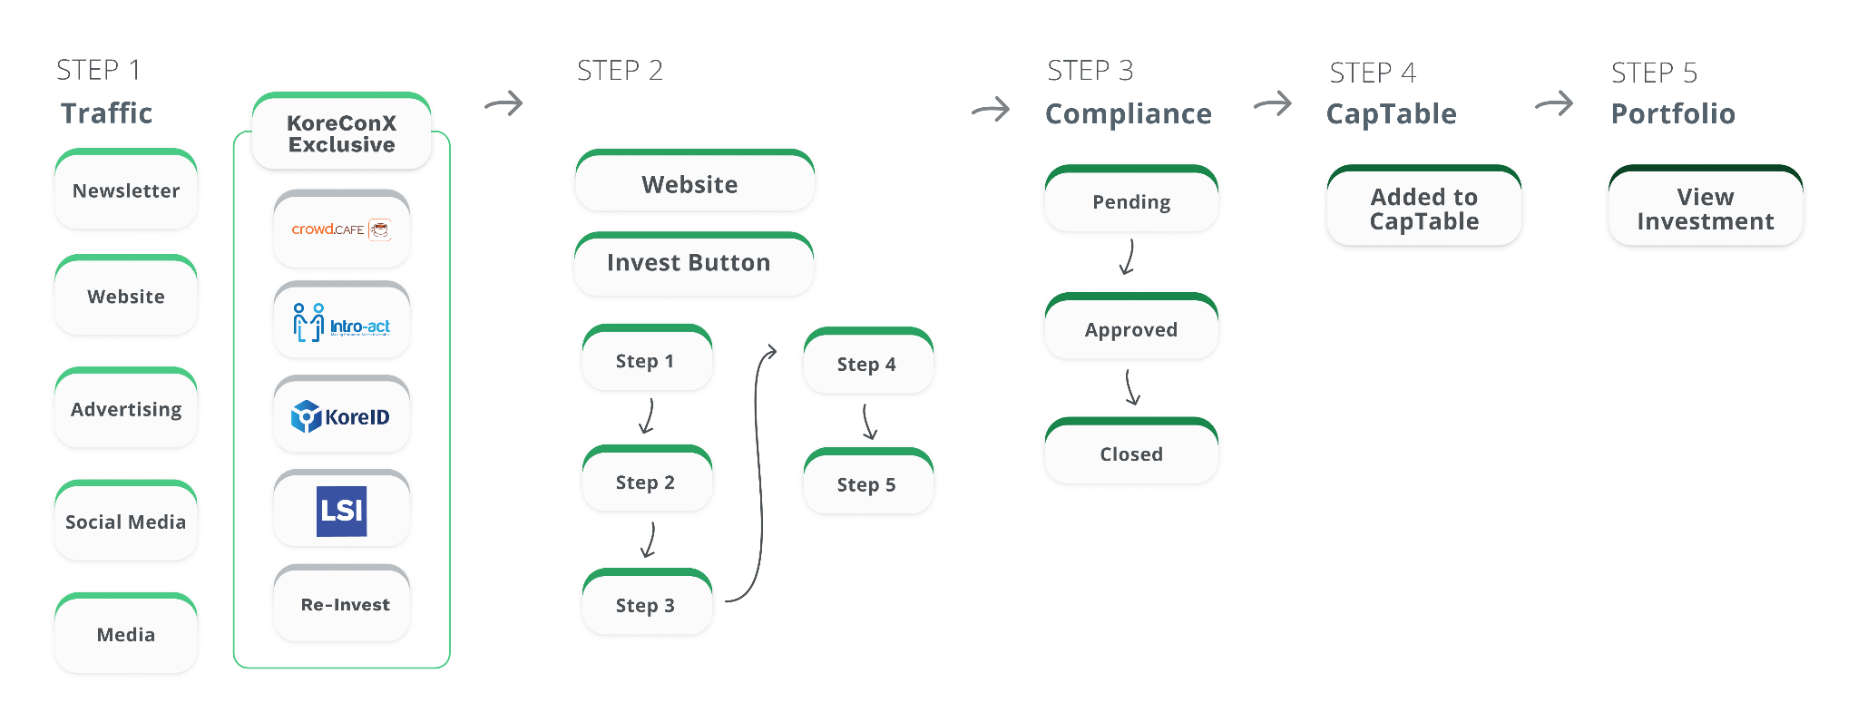
Investor Acquisition Journey
Medical Funding Professionals

Slide 27
Investor Acquisition 3 Lanes
Accredited Investors
Brand Marketing
Non-Accredited Investors
Financial Newsletters
Email Marketing
Direct Outreach
Video
Content Marketing
Public Relations
Digital Advertising
Social Media
Webinars
Medical Funding Professionals

Slide 28
Deep Investor Acquisition Experience
F
Cityzenith
AI software for City Planners
Phoenix Capital Group
Mineral Rights Acquisitions
Legion M
Fun-funded Entertainment
More than $10 million raised through Regulation A+ for an innovative software platform transforming urban planning.
Ad Management
Webinar Production
Landing Pages
Testimonial Videos
$75 million Regulation A+ for a holding company making acquisitions of mineral rights for the energy industry.
Brand & Identity
Ad Management
Webinar Production
Marketing Automation
Landing Pages
More than $11 million from 35,000 investors in a series of record breaking campaigns for a fan-funded media company.
Ad Management
Webinar Production
CRM Management
Landing Pages
Create your offering, including compelling content to drive engagement.
Medical Funding Professionals
Click here to see a live Regulation A+

Slide 29
How to prepare for success
Preparation before the launch is essential to long-term success. Focuses on at least 2-3 months of pre-marketing to build an active audience of prospective investors through our Rapid Launch Plan.
FOUNDATION
For sustainable investor & customer growth
What happens during your Rapid Launch Plan?
FOOTPRINT
Optimized digital presences for company and team members
Create a compelling, distinct offering
Define investor audiences
Acquire targeted 1st-party data sets
Build out advertising creative & messaging
Set up marketing funnels and automation
Test the Water campaigns
CRM setup, tracking, and data integrations
Create your offering, including compelling content to drive engagement.
THOUGHT LEADERSHIP
Position team members for success in the marketplace
Medical Funding Professionals
DRIVE TRAFFIC
SEO, SEM, PPC, Social, and more to generate interest
REFINE & ADJUST
Make changes to drive down acquisition costs and scale

Slide 30
What Happens Next?
$
Create your offering, including compelling content to drive engagement.
Obtain SEC Qualification for your Reg A+ offering, a process that usually takes from 60 to 90 days.
Your offering will then be launched on a Virtual Roadshow on your own website.
Investor capital is then raised and transferred to your company via escrow.
Medical Funding Professionals
Click the button below to see an example of what a Reg A+ offering looks like on the Virtual Roadshow.
Click here

Slide 31
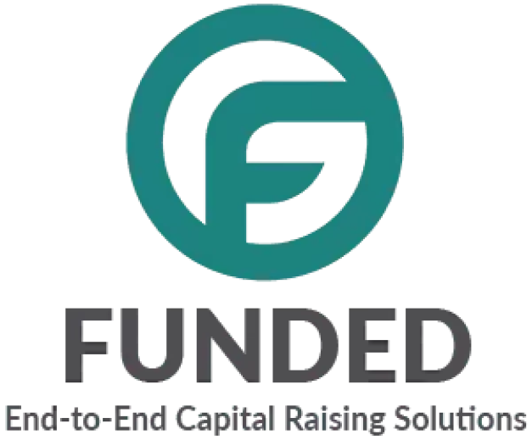
Investor Acquisition Firms
Investor
Acquisition
Firms
Experience with JOBS Act
Combined have done more than 300+ Offerings
Each IA Firm has specialty
Each offering is different
Institutional IA
Medical Funding Professionals

Slide 32
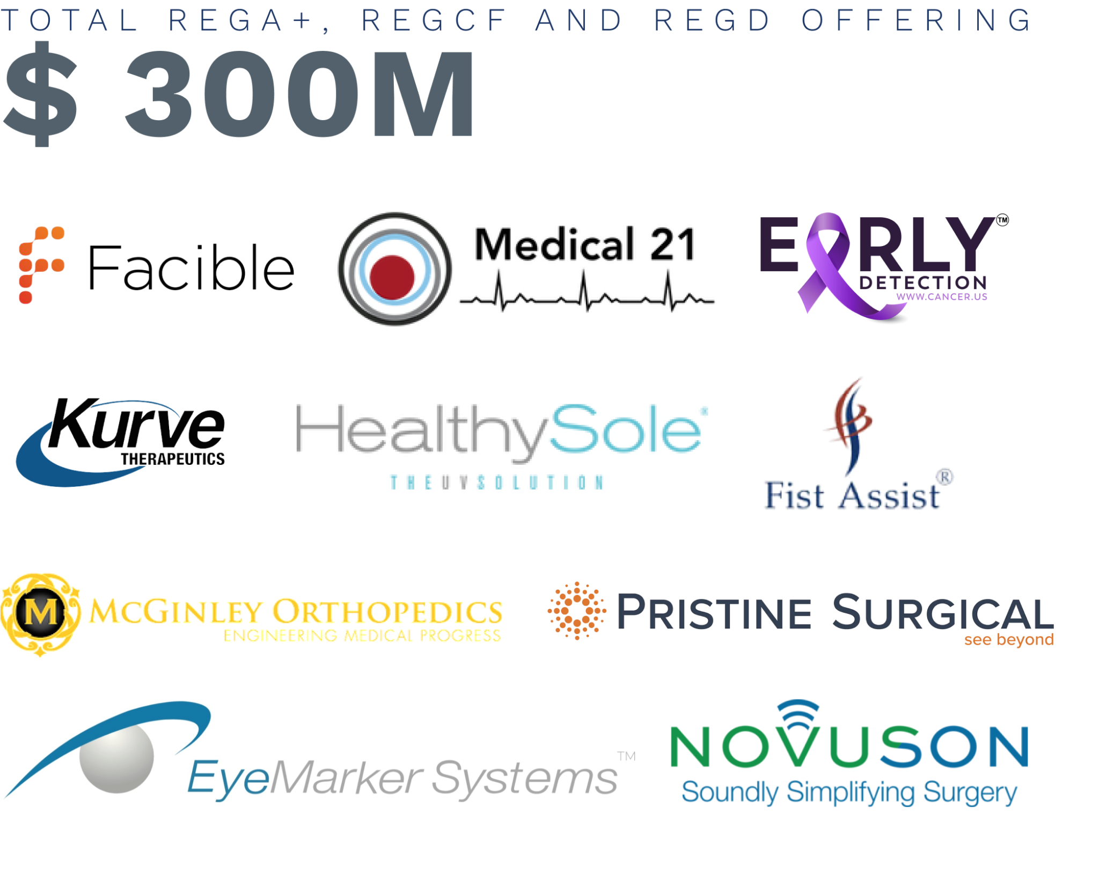
Medical Funding Professionals
Medical Funding Professionals

Slide 33
Next Steps Timeline
Capital is raised and transferred to your company via escrow
Agreement signed
Legal & audit prep
Create your offering
SEC Qualification
Team onboarding
Marketing prep & pre-launch
Fintech setup
Raise launch
Listed Institutional Platform
Crowd.Cafe
Medical Funding Pro
LSI
KoreConX
RDR
FINRA BD
Investor Acquisition
Medical Funding Professionals

Slide 34
Disclaimer
Medical Funding Professionals (MFP) is a registered investment advisor located in Nevada. MFP and its representatives are in compliance with the current filing requirements imposed upon registered investment advisors by those jurisdictions in which MFP maintains clients. MFP may only transact business in those states in which it is registered or qualifies for an exemption or exclusion from registration requirements.
None of the information contained here constitutes an offer (or solicitation of an offer) to buy or sell any product or financial instrument, to make any investment, or to participate in any particular investment, offering, or trading strategy. The information and materials provided here, whether or not provided on MFP emails, website/webpages, on third party websites, in marketing materials, newsletters or any form of publication are provided for general information and educational purposes, and do not constitute legal advice or investment advice. MFP not an attorney or broker-dealer. Investment involves risk. Past performance is not indicative of future performance. If you have any questions, you should seek independent professional advice.
Medical Funding Professionals

Slide 35
Reg A+ funding, which allows firms to raise up to $75M per year, faster, easier, with less hassle, higher valuation and less dilution than other traditional fundraising approaches; and
Government grants and other non-dilutive funding sources such as cooperative agreements and other non-traditional government-backed strategies that allow firms in the BioTech, MedTech, Life Sciences & Pharma sectors to secure capital to:
Research, develop and commercialize innovative technologies, products and solutions;
Deploy pilot or demonstration projects;
Conduct research to empirically validate new technologies, products or solutions;
Expand market reach and acquire new customers;
And more—without giving up equity.
MFP provides funding solutions for short- and long-term startups as well as mid-market private & public companies in the Biotech, Medtech, Life Sciences & Pharma industries through:
Medical Funding Professionals
medicalfundingpro.com

Slide 36
LSI is a market research and advisory firm focused on the medtech space. Founded in 2006, the company provides consulting and advisory services to leading innovators, ventured funded startups, large strategics, investors and professional services companies. We help our clients make the best strategic and investment decisions possible through our unique data, insights and unbiased perspective on existing and emerging markets.
In an era with an overabundance of data, we believe it is more important than ever for our clients to make their key strategic decisions based on unique and timely insights. Our team of market researchers, economists, and analysts have a deep understanding of the global healthcare system and the medical device, diagnostic, and digital health technologies that are rapidly evolving.
We guide our clients using actionable data so they can identify the most important trends, opportunities, and “watch-outs” as they aim to deliver life changing technologies to patients around the globe.
We help our customers make better strategic decisions so they can compete and grow — that is our mission. We do this by delivering market data, insights and connections.
We are the producers of Medtech Pro, an online market intelligence tool delivering: market forecasts, share by supplier data, trend & opportunity assessments, procedure volume forecasts, startup company monitoring, deals data and more.
LSI is the host of the annual Emerging Medtech Summit held annually in Southern California, which provides a global forum bringing together the industry’s top medtech innovators, investors, and strategic buyers.
At LSI, our mission is to provide unique market insights so our clients can deliver life-changing technologies, faster.
Medical Funding Professionals
lifesciencemarketresearch.com

Slide 37
KoreConX is the world's first highly-secure permissioned blockchain ecosystem for fully-compliant digital securities worldwide.
An all-in-one platform for companies raising capital.
KoreConX is the first of its kind, an all-in-one platform that unites tools to securely and efficiently manage essential business data and facilitate compliance.
To ensure compliance with securities regulation and corporate law, the KoreConX All-In-One platform and End To End process solution with Secondary Market ATS is an AI-based blockchain platform, the KoreChain, manages the full lifecycle of digital securities including the issuance, trading, clearing, settlement, management, reporting, corporate actions, and custodianship. KoreConX connects companies to the capital markets and secondary markets facilitating access to capital and liquidity for private investors.
KoreConX is the first secure, End To End solution for private companies to manage their capital market activity and stakeholder communications. Removing the burden of fragmented systems and inefficient tools across multiple vendors, KoreConX offers a single environment to connect companies, investors and broker dealers. Leveraged for investor relations and fundraising, private companies can share and manage corporate records and investments including portfolio management, capitalization table management, virtual minute book, security registers, transfer agent services, and virtual deal rooms for raising capital.
Medical Funding Professionals
koreconx.com

Slide 38
Regulation D Resources (“RDR”) was formed in 1999 to provide Private Placement Offering preparation and execution support services to entrepreneurs and growing private companies.
Regulation D Resources provides Regulation D, Regulation CF and Regulation A+ offering preparation, custom Investor Portal websites, and capital access.
Headquartered in Lakewood, Colorado, RDR is one of the leading Regulation D, Regulation CF and Regulation A+ private placement advisory service providers in the United States with a comprehensive matrix of services that spans transaction structuring, offering preparation, assistance with SEC and State securities compliance, and access to the capital markets through RDR’s broker-dealer relationships and FINRA broker-dealer resources.
Medical Funding Professionals
www.regdresources.com

Slide 39
After years of working at traditional international accounting firms, the founders of Assurance Dimensions determined that a new service model was required. Our three differentiating factors are related to the use of only experienced personnel, focus on client service and fixed fee pricing. Experienced personnel make the engagements much more efficient and effective for the client and provide more value to senior management from a consultative perspective.
Focusing on client service means that we professionally tailor our engagements through communication and understanding of your organization to align our goals with yours. The fixed fee pricing allows our clients to feel comfortable calling us anytime during the year with no risk of additional billing.
This factor creates an environment where significant accounting issues and questions are addressed early in their life cycle which allows for the most efficient resolution. We view our role in the financial reporting process as an opportunity to provide constructive solutions for maximizing your company’s profitability and efficiency.
We specialize in auditing companies and preparing them to have the required financial information to file their form 1-A. We completed more than 40 audits for Reg A filings in fiscal 2021. In order to file a form 1-A the SEC requires a two year audit of your last 2 most recently closed fiscal year ends. Based on these requirements, unless previously audited we would have to audit your 2019 balance sheet and your 2020 and 2021 balance sheets and statements of operations.
These audits are under completed under Generally Accepted Accounting Principles and can be under either AICPA or PCAOB auditing standards. Assurance Dimensions is unique with its PCAOB accreditations that is has the ability to audit your financials under AICPA rules and if your company decides in the next 2 years to go public we can convert that audit to PCAOB standards for a minimal cost.
Assurance Dimensions is a leading CPA firm in Florida. We offer assurance, tax and advisory services to private, public and nonprofit clients nationwide and internationally
Medical Funding Professionals
https://assurancedimensions.com

Slide 40
Active
Raise
Examples
Want to see exactly what a Reg A+ offering looks like?
Below are some current live Reg A+ offerings:
Monogram Orthopedics – Orthopedic implant / robotic surgery company raising $30M at $6.27/share
Biologx – Affordable insulin at 40 to 65% less than current US market prices raising $50M at $4/share
Medical Funding Professionals

